Slide 1
Analysis of Drug review data using data analytics methods.
CIND 820 Big Data Analytics Final project
Student name: Vinay Gorrepati
Student ID: 500728854
OEN: 378147490
Supervisor: Dr. Ceni Babaoglu

Slide 2


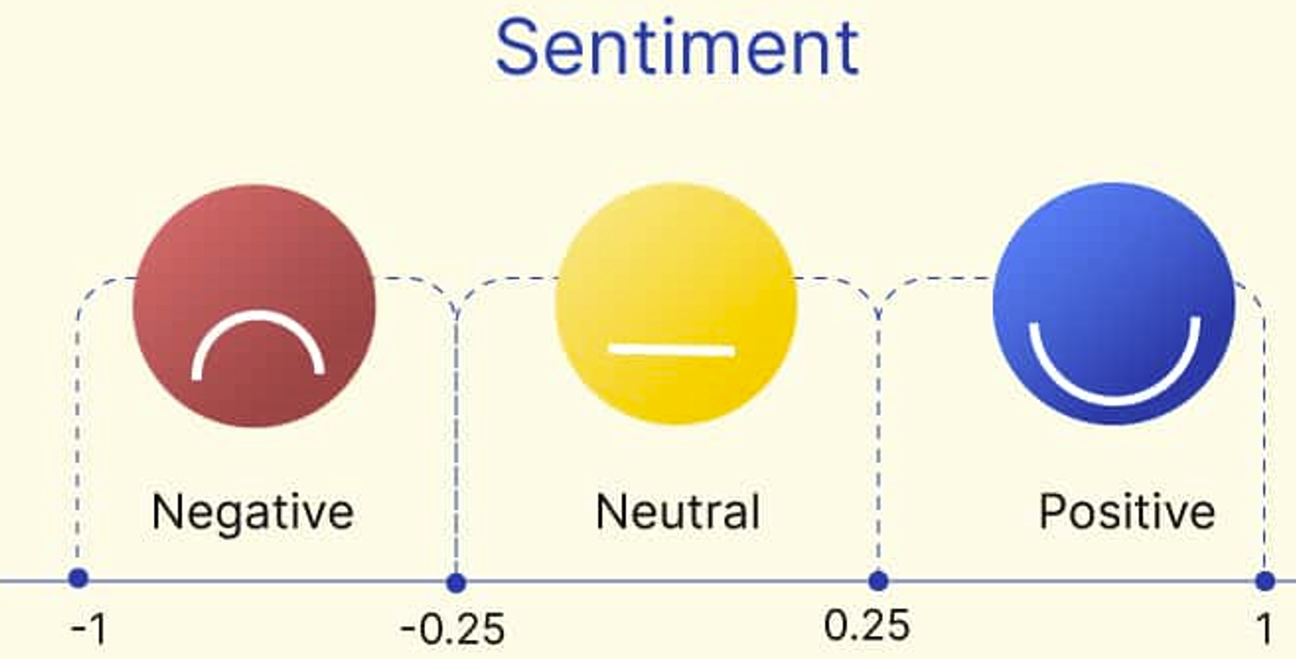
Introduction
The UCI ML Drug Review dataset :
Patient drug review data obtained by web scraping Drugs.com.
Patient reviews on specific drugs along with related conditions
A 10-star patient rating system reflecting overall patient satisfaction
This project will attempt to answer the following.
What are the Top drugs for a given condition?
Can the Drug rating be predicted based on the reviews?
Can we determine if a review is positive or neutral or negative?

Slide 3

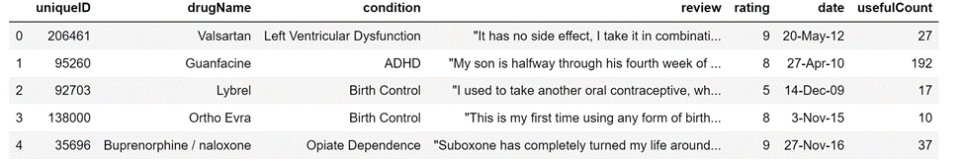
About the Dataset
Test Data.csv
Train Data.csv
Combined Data .csv
215,063 instances with 6 different columns and 1 unique id column.
The dataset was differentiated into Test and Train data.
A combined Data set was created
Patient reviews on specific drugs along with related conditions
A 10-star patient rating system reflecting overall patient satisfaction.
The data is complete with only < 0.5% of condition data missing.
Deleted the missing data

Slide 4
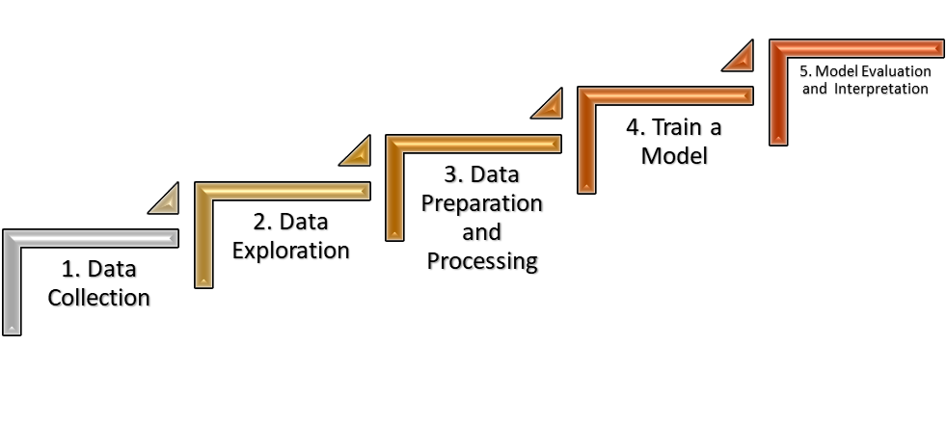
Data Approach and Methodology

Slide 5


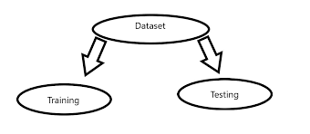






Steps taken towards the objective
Explore the Data
‘Clean’ and Prepare the Data
Split the Data
Build the Model
Present the Findings
Validate the Model
Test the Model
Train the Model

Slide 6











Tools Used for Data Analytics

Slide 7
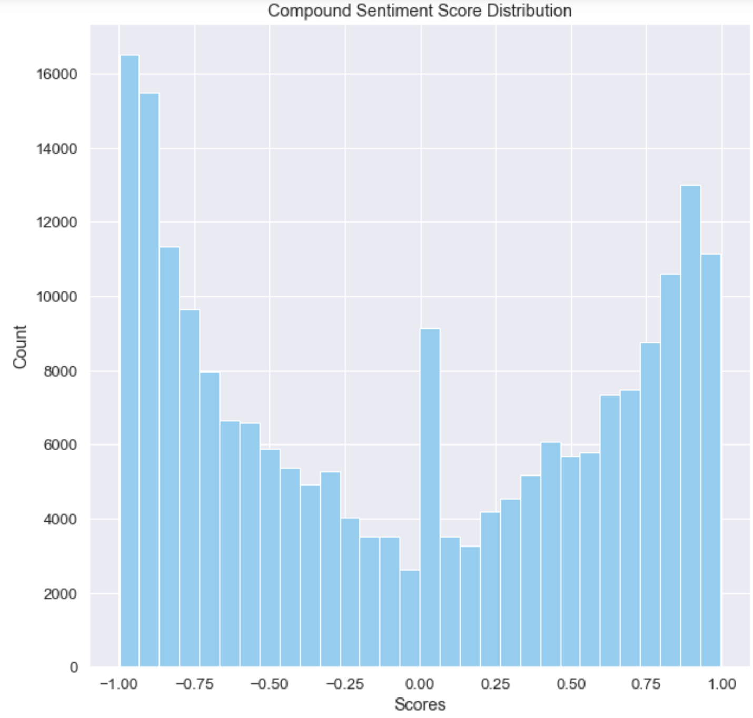
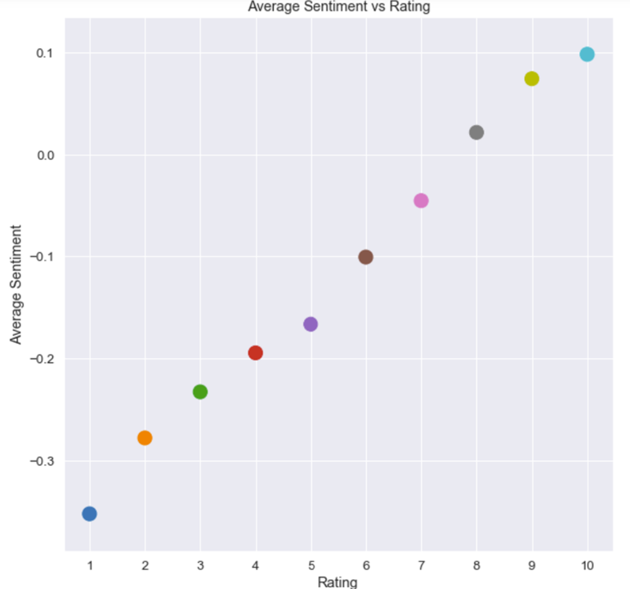
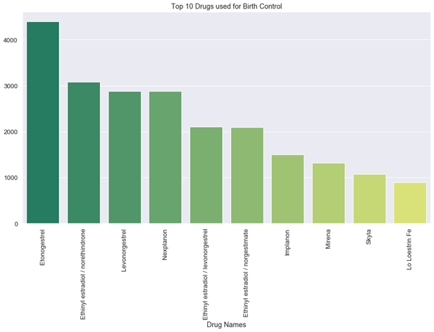
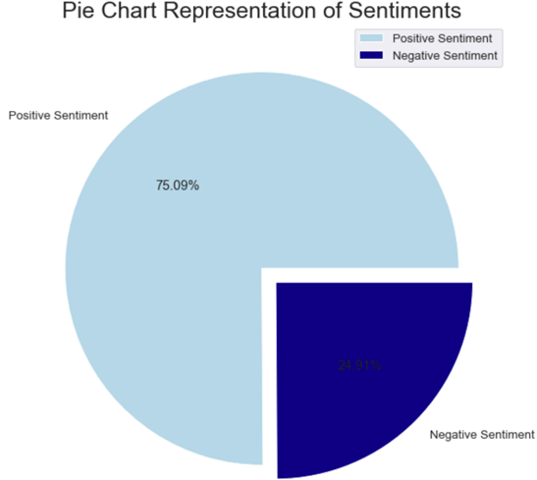
Data Exploration : A few examples
Given a condition the top 10 drugs by count can be identified .
The majority of the reviews have positive sentiment ( >=5 rating).
Higher the rating the more positive the sentiment.

Slide 8
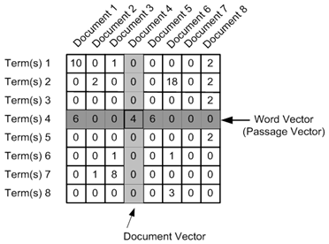
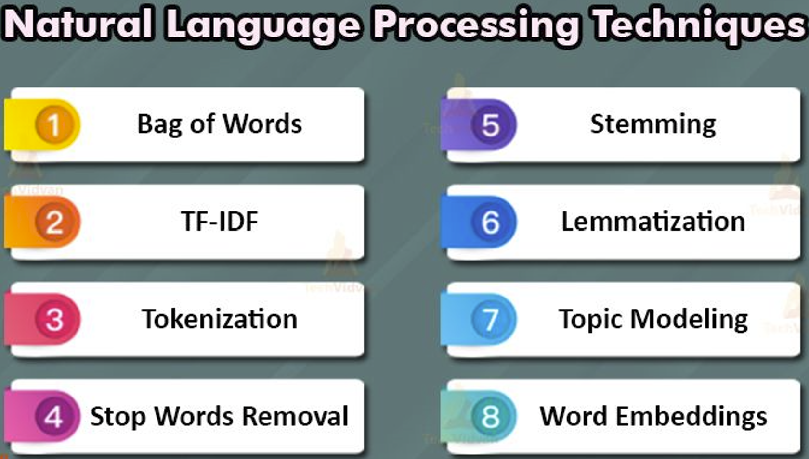

Prediction: Feature Engineering and Model building
NLP : Natural Language Processing
TF-IDF : Term frequency-inverse document frequency
It is a numerical statistic
How important a word is to a document in a collection or corpus?

Slide 9
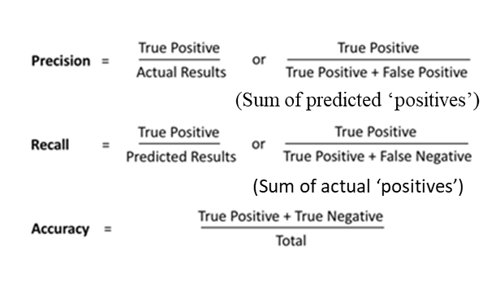
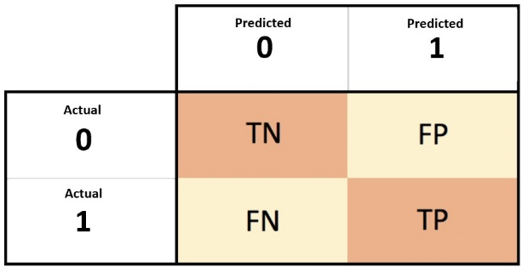
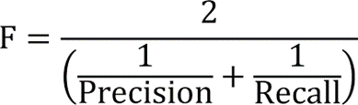
Prediction: Feature Engineering and Model building
Predict the Drug rating (Dependent Variable) based on the review(Independent Variable).
Naive Bayes Classifier
Logistic Regression
Random Forest Classifier
eXtreme Gradient Boosting algorithms
Confusion Matrix

Slide 10
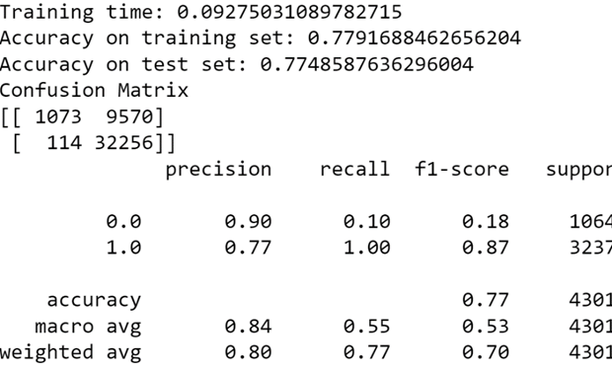
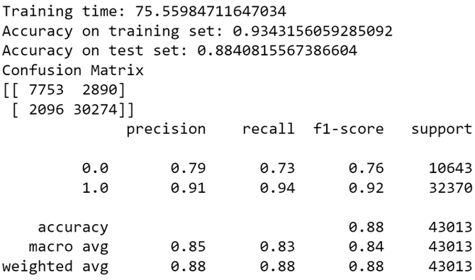
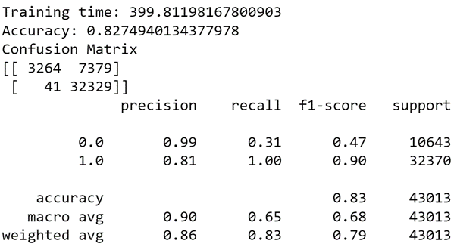
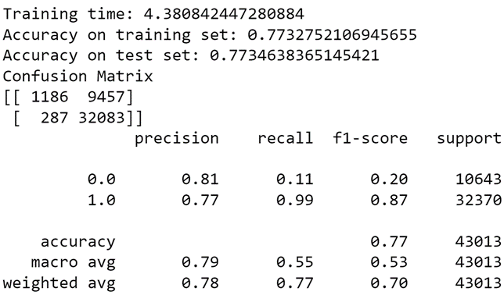
Confusion Matrix
Naive Bayes Classifier 3. Logistic Regression
Random Forest Classifier 4. eXtreme Gradient Boosting algorithms

Slide 11
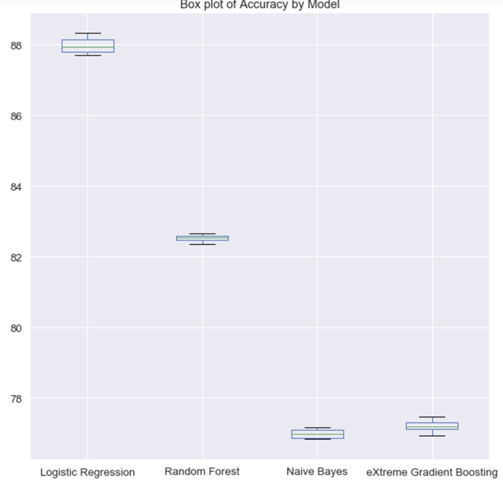
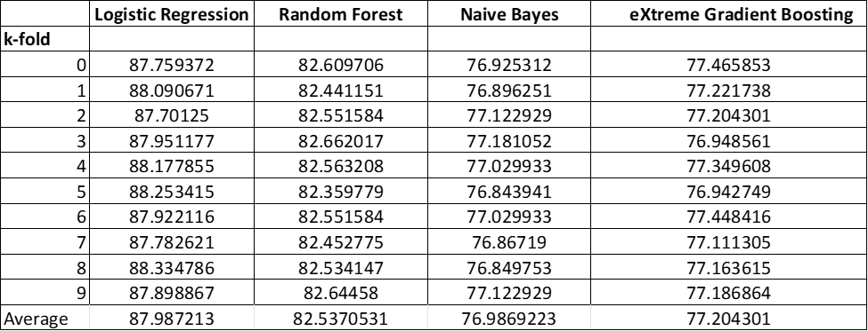
Cross-validation : k-fold
Comparing the four models using the Accuracy metric, it becomes clear that Logistic Regression gives the most accurate predictions.

Slide 12
Conclusion
This project attempted to answer the following 3 research questions.
1. What are the Top drugs for a given condition?
Top conditions in the data were identified and for any of the top conditions the top drugs by rating were identified.
Can the Drug rating be predicted based on the reviews?
Four algorithms were explored namely, Naive Bayes Classifier, Logistic Regression , Random Forest Classifier, eXtreme Gradient Boosting and based on Cross-validation results the Logistic Regression algorithm was selected as it has the best accuracy.
3. Can we determine if a review is positive or neutral or negative?
Sentiment Analysis was conducted on the reviews to identify if a review is positive, neutral, negative and it was inferred that a drug with a higher average rating generally has a higher, more positive average sentiment

Slide 13
Shortcomings
A better programmer with deeper knowledge of Machine Learning, Python would have done a lot more.
More work can be done to build a prediction model to predict the condition based on the reviews.
Explore more algorithms which might perhaps deliver better accuracy and performance.
A better drug recommendation tool could be built from this data and perhaps it could be connected directly to the drugs.com website to take in live data instead of a static dataset as used in this project.

Slide 14
Thank you for your attention: Dr. Ceni Babaoglu Dr. Zekiye Erdem Any Questions ?
The Codes and results are on GitHub :
https://github.com/vgorrepa/Big_Data_Final_Project

